Slide 1
1918: Nelson “Von der Kunst des Philosophierens”
100 jaar praktijk, 100 jaar theorievorming: spoort dat nog?
Het Nieuwe Trivium - filosoferen in organisaties

Slide 2
Mijn betrokkenheid:
1979: Studie Wijsbegeerte (VU, drs 1988)
1985: Jos Kessels begint met het begeleiden van Socratische Gesprekken
1986: Oprichting studierichting ‘Filosofie in Bedrijf’
1989: Philips, later Bureau Zuidema (management opleider, gespreksvaardigheidstrainer)
1990: Deelname Socratisch Gesprek (ISVW)
1992: Seminar Philosophisch Politische Akademie (Berlijn); aan de slag als gespreksleider op de ISVW
1994: Jos Kessels: Nelson over de Socratische Methode
1995: Würzburg Tribunal: “MacDonaldisierung”
1997: Jos Kessels “Socrates op de markt: filosofie in bedrijf”
1997: Oprichting Virtus Advies en Centrum voor Organisatiefilosofie (met ISVW)
Het Nieuwe Trivium - filosoferen in organisaties

Slide 3
Mijn betrokkenheid:
1998: vz. intervisiegroep Socratische Gespreksleiders; Internationale Conferentie
1999: Oprichting Het Nieuwe Trivium met Jos Kessels
2000: Loccum conferentie; voordracht over plicht om in organisaties aan de slag te gaan
2002: Vrije Ruimte: filosoferen in organisaties
2007: Vrije Ruimte Praktijkboek
2012: Start promotieonderzoek naar toepassing Socratisch Gesprek in organisaties en de theoretische onderbouwing daarvan (Radboud Universiteit; afronding 2019)
2016: Socratische Landdag oprichting onderzoeksgroep
Het Nieuwe Trivium - filosoferen in organisaties

Slide 4
5 generaties Socratisch Gesprek; verschuivingen in de praktijk
* Socrates
* Nelson
* Heckmann
* Philosophisch Politische Akademie
* Korte Socratische Dialoog
Het Nieuwe Trivium - filosoferen in organisaties

Slide 5
Theorievorming:
Bestudeerd o.a. Nelson, Heckmann, Raupach Strey, Horster, Gronke, Kessels, Bolten, Boele, Van Rossem
Het Nieuwe Trivium - filosoferen in organisaties

Slide 6
Directe toegang tot waarheid?
Nelson:
We have to postulate the existence of non-reflective immediate perception.
Het Nieuwe Trivium - filosoferen in organisaties

Slide 7
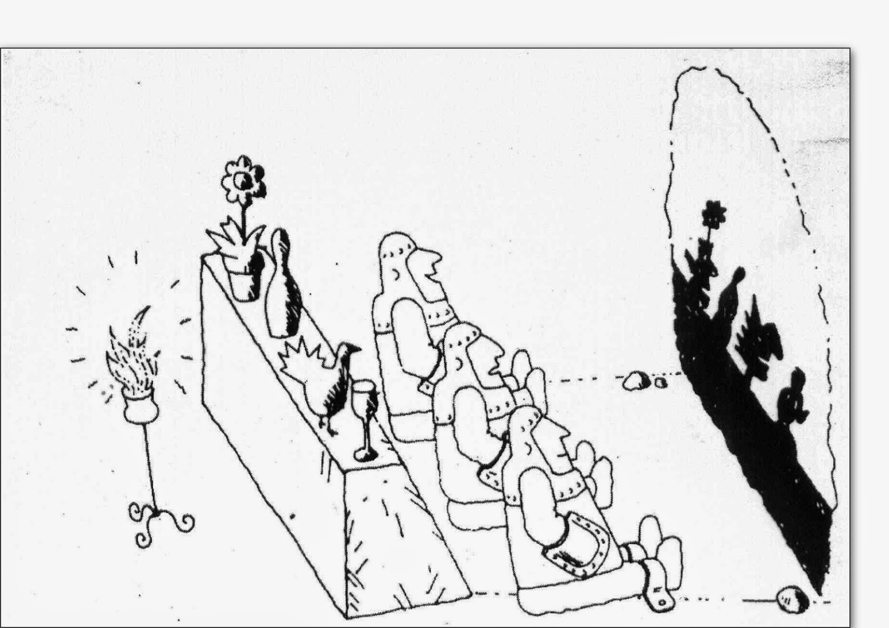
Directe toegang tot waarheid?
Het Nieuwe Trivium - filosoferen in organisaties

Slide 8
Vertrouwen in (universele) rede?
Nelson:
We have discovered philosophy to be the sum total of those universal rational truths that become clear only through reflection. To philosophise, then, simply means to isolate these rational truths with our intellect and to express them in general judgments.
Het Nieuwe Trivium - filosoferen in organisaties

Slide 9
Noodzaak consensus?
Heckmann:
Whenever we reach consensus about a statement in a Socratic Dialogue it has a provisional character. For the moment there are no further doubts about the outcome of our effort.
Het Nieuwe Trivium - filosoferen in organisaties

Slide 10
Argumentatieve gespreksvoering?
Raupach-Strey:
A Socratic Dialogue is an argumentative enquiry by a conversation community, based on personal experience. It tries to find out the truth about a philosophical question by striving for consensus about the answer, after collectively testing its validity.
Het Nieuwe Trivium - filosoferen in organisaties

Slide 11
Conceptuele verheldering?
Horster:
We have to reflect on a concept while using concepts that cannot be examined at the same time. There is no other working tool. (‘Begriffsarbeit’)
Het Nieuwe Trivium - filosoferen in organisaties

Slide 12
Impliciete kennis expliciet maken?
Gronke:
The Socratic question looks for a clear and tested knowledge which still has to clarify an implicit pre-existing knowledge.
Het Nieuwe Trivium - filosoferen in organisaties

Slide 13
Rol van het gesprek?
Birnbacher:
Like Socrates, Nelson holds that philosophical truths are accessible for both the solitary thinker and for the group dialogue. This implies that these insights are conceived independent of the dialogue itself.
Het Nieuwe Trivium - filosoferen in organisaties

Slide 14
Rol van taal?
Citaat Nelson
The essence of philosophical knowledge makes it necessary that the words a philosopher uses to share his thoughts refer to clear-cut and well defined concepts. … That’s why we have to reject philosophical metaphors. An image leaves our thinking with too much leeway.
Herder:
Thought is essentially dependent on and bounded by language—i.e., one can only think if one has a language, and one can only think what one can express linguistically.
Searle:
We tell people how things are, we try to get them to do things, we commit ourselves to do things, we express our feelings and attitudes and we bring about changes through our utterances. Often we do more than one of these at once in the same utterance. Davidson:
There is no such thing as language, not if a language is anything like what many philosophers and linguists have supposed. There is therefore no such thing to be learned, mastered, or born with. We must give up the idea of a clearly defined shared structure which language users master and then apply to cases.
Het Nieuwe Trivium - filosoferen in organisaties

Slide 15
Speechacts
“I read an article in the newspaper this morning on the train. It was about the drastically increased tendency among young people to put piercings on various parts of their body. That, according to the author, is worrisome and harmful to health. That’s nonsense of course! …”
Core statement: This article is nonsense because it is an exaggeration to say that this tendency has increased drastically and it is not true that it harms health. Nowhere is this scientifically proven.
(Kristof van Rossum in Understanding the other and oneself)
Het Nieuwe Trivium - filosoferen in organisaties

Slide 16
Question
Example
Core statement/Crucial moment
Rules
Principles
Kernbewering of cruciaal moment?
Zandlopermodel:
Question
Example
Core statement/Crucial moment
Rules
Principles
Het Nieuwe Trivium - filosoferen in organisaties

Slide 17
Van wie zijn onze gedachten?
Conversation-analysis:
In this example B sits in his office, C knocks on the doorpost, B invites C to come in and C enters.
1 B: Why don’cha flick on the lights (0.9)
2 I’ve (0.6) discovered th’t (0.3) I’m in the dark
3 (0.9)
4 C: huhh .hh
5 B: hh .hh Which actually is: (0.6)
6 an enlightening experience
7 C: hh heh heh heh
8 .hh t’ discover it? or t’be.
9 B: t ’discover it.
Het Nieuwe Trivium - filosoferen in organisaties

Slide 18
Waarheid of betekenis?
Nelson:
Arendt:
The distinction of the two faculties, reason and intellect coincides with a distinction between two altogether different mental activities, thinking and knowing.
The need of reason is not inspired by the quest for truth but by the quest for meaning. And truth and meaning are not the same.
Het Nieuwe Trivium - filosoferen in organisaties

Slide 19
Denken of oordelen?
Citaat Hannah Arendt
Thinking, willing and judging are the three basic mental activities; they cannot be derived for each other and though they have certain common characteristics they cannot be reduced to a common denominator.
Het Nieuwe Trivium - filosoferen in organisaties

Slide 20
Logos, pathos of ethos?
Kessels:
Furthermore the ‘pathos’ of the argumentation needs to be checked. Does it feel right? What are your emotions anyway concerning this statement and its justification? Does it touch you?
Het Nieuwe Trivium - filosoferen in organisaties

Slide 21
Sophia, phronèsis of sunesis?
Kessels:
In a Socratic Dialogue you won’t find episteme, but phronesis … no external knowledge, presented by others as important, but inner knowledge, self-discovered, closely linked to our own experience and or own mental models.
Aristoteles:
Understanding [sunienai, zie not JdV] is neither the having nor the acquiring of practical wisdom; but as learning is called understanding when it means the exercise of the faculty of knowledge, so 'understanding' is applicable to the exercise of the faculty of opinion for the purpose of judging of what someone else says about matters with which practical wisdom is concerned-and of judging soundly
Hence it is about the same objects as practical wisdom; but understanding and practical wisdom are not the same. For practical wisdom issues commands, since its end is what ought to be done or not to be done; but understanding only judges.
Het Nieuwe Trivium - filosoferen in organisaties

Slide 22
Consequenties voor de praktijk?
Situatie en kernbewering Socratische Landdag 2016
Cruciaal moment:
Hans: “ Zal ik dan op jouw plaats gaan zitten?”
Erik: “Ja”
(Terwijl Erik zijn spulletjes bij elkaar pakt, opstaand) Hans: ‘Aan wie stel ik de vraag eigenlijk?’
Uitspraak op flipover:
Erik gaf antwoord (‘Ja’) op Hans’ vraag (‘Zal ik dan daar gaan zitten?’)
Het Nieuwe Trivium - filosoferen in organisaties

